Slide 1
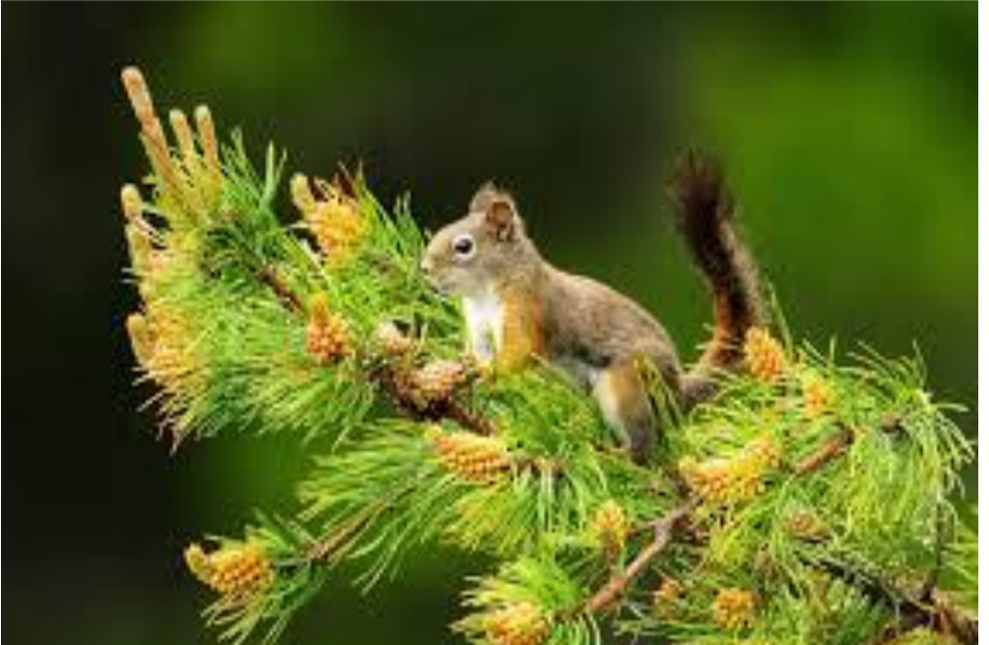
III A Turismo
School Year 2020/2021
RESPONSIBLE AND SUSTAINABLE TOURISM
Geography-English
CLIL CLASS
English teacher Antonia Malizia
Geography teacher Gianluca Del Piccolo
ITES FRACCACRETA

Slide 2
RESPONSIBLE AND SUSTAINABLE TOURISM
https://youtu.be/v401LIaSQps

Slide 3
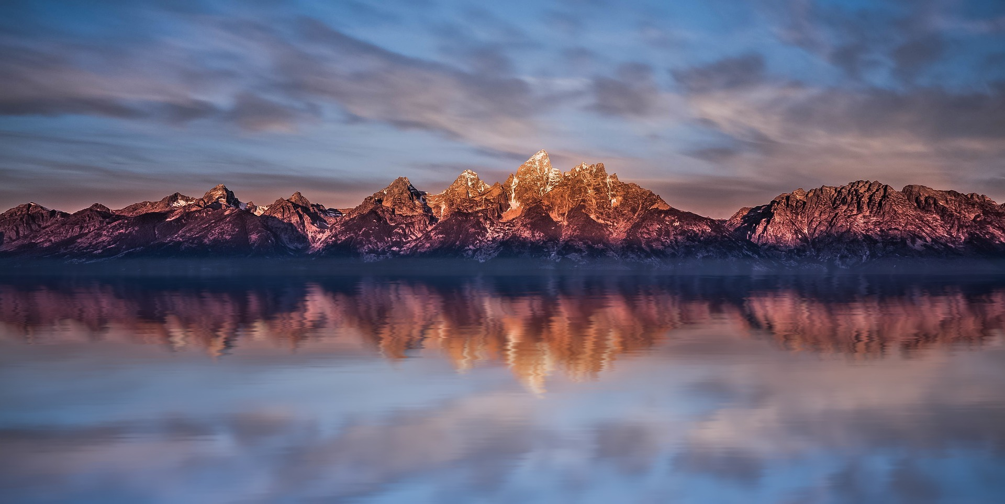
KEEP SILENCE CLOSE YOUR EYES OPEN YOUR MIND IMAGINE IMAGINE THE WORLD WHERE TO RAISE YOUR CHILDREN
https://youtu.be/g1FrBGqablM
Dragonfly flight

Slide 4
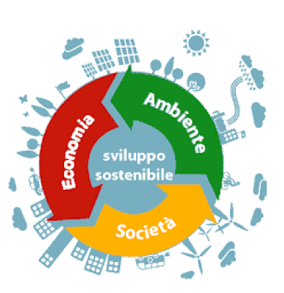
WHAT IS THE SUSTAINABLE TOURISM?
Sustainable Tourism means meeting the needs of today’s tourists and host regions by anticipating and increasing opportunities for the future.
All resources should be managed in such a way that economic, social and aesthetic needs can be met.
That happens maintaining cultural integrity, essential ecological processes, biological diversity and the living systems of the area in question.
Economy, Ethics and Environment are three fundamental rules on which sustainable tourism is based.
2° RULE
1° RULE
3° RULE

Slide 5
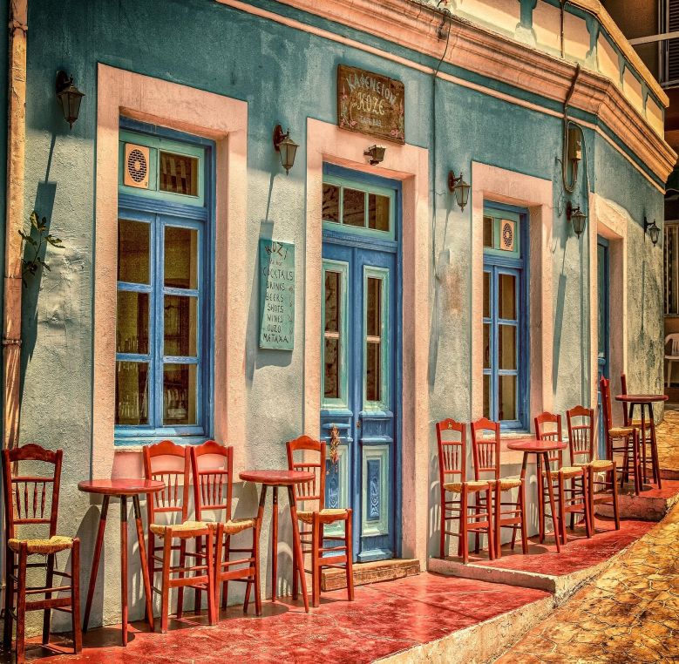
A TOURISM THAT LOOKS TO THE FUTURE
Sustainable tourism products are those that act in harmony with the local environment, community and cultures, so that they are the beneficiaries and not the victims of tourist development.
Sustainable tourism therefore looks to the future: it is a set of practices and choices that do not harm the environment and promote to the improvement of the quality of life of the residents.

Slide 6
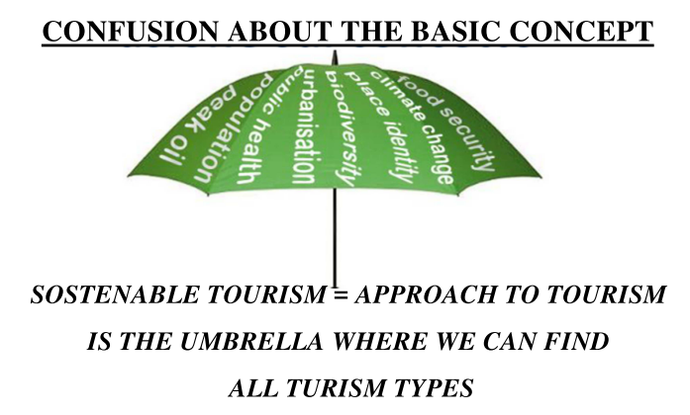
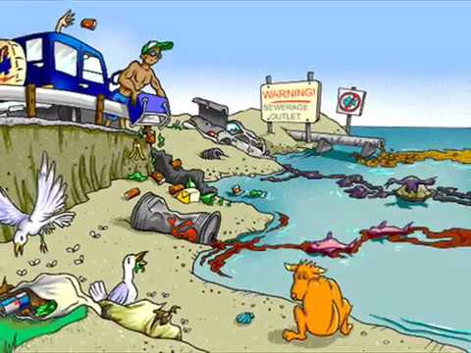
SUSTAINABLE TOURISM AS AN UMBRELLA CONCEPT
Sustainable or Responsible Tourism = a tourism able to match, in the short and long time, the expectations of residents with those of tourists without decreasing the quality of the tourist experience and without damaging the social and environmental values of the territory, stimulating benefits for the territory, for tourists and for the local community.
https://youtu.be/x4bK5lZ1uBw
Sustainable Tourism Case Study

Slide 7
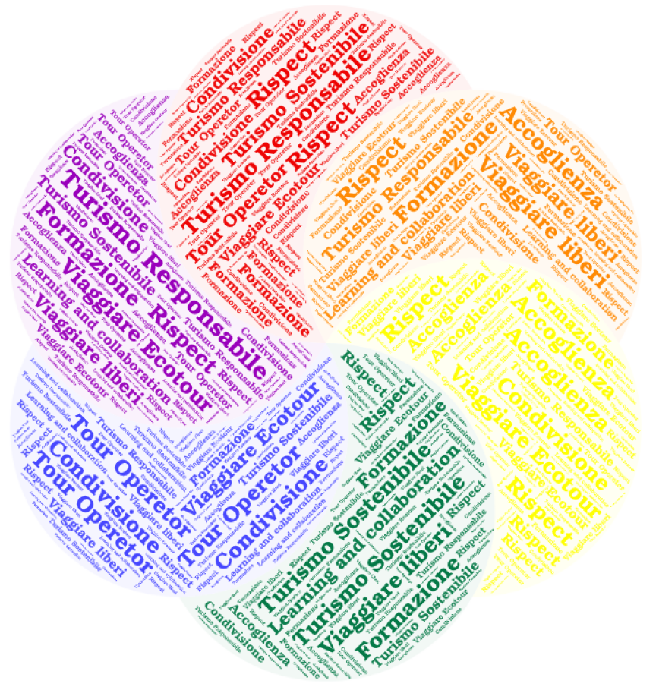
SUSTAINABLE TOURISM AND DEVELOPMENT: THE PARTECIPATION OF THE LOCAL COMMUNITY
Sustainable development is discussed when all the actors in the territory concerned can participate in decision-making processes.

Slide 8
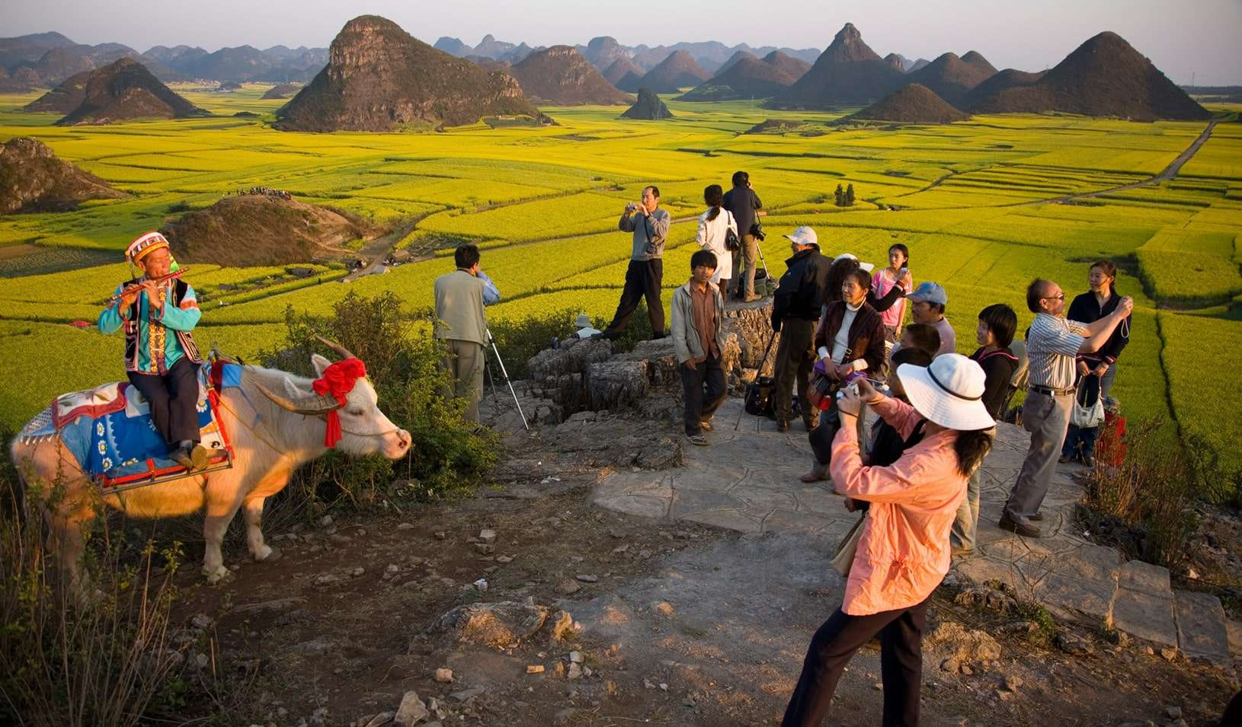
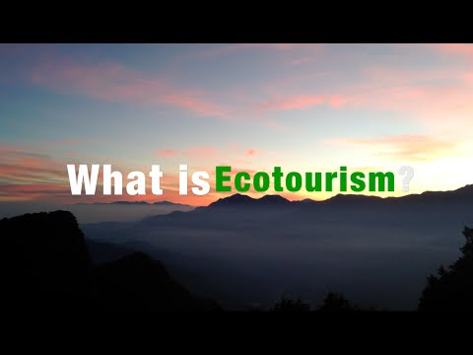
SUSTAINABLE TOURISM AND DEVELOPMENT:
IMPROVING THE TOURIST EXPERIENCE
Improving relations between tourists, local communities and territory, sustainable tourism also improves the tourist experience itself.
As Goodwin, in fact, supports “responsible tourism is a tourism that creates best destinations to live for residents and visit for tourists.”
https://youtu.be/RDIfFTs9V1A
What is Ecotourism?

Slide 9
THE EUROPEAN UNION AND SUSTAINABLE TOURISM
In addition to the ETIS system, the European Union intervenes in different ways in the discourse on sustainable tourism:
In the case of tourism, the European Commission provides a sectoral reference document for the tourism sector which illustrates best environmental management practices within tourism sector organizations providing accommodation, catering, manage tourist destinations or provide travel, accommodation or tourism activities (travel agencies and tour operators).
Tourism and environment reporting mechanism (TOUERM), specific indicators for the tourism sector.
I believe that having land and not ruining it is the most beautiful art form you could ever want.
Andy Warhol

Slide 10
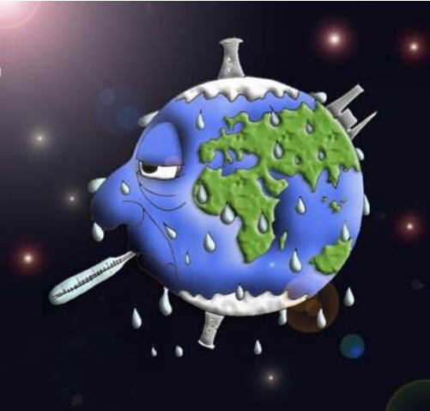
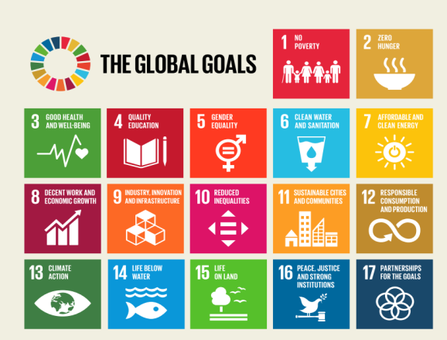
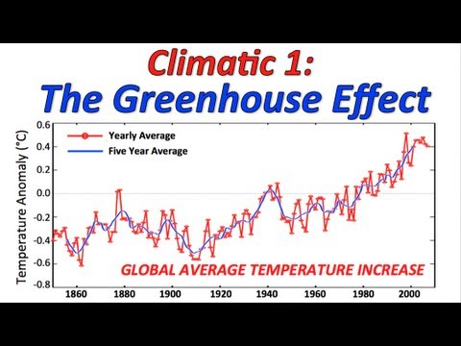
SUSTAINABLE DEVELOPMENT
Development characteristic traits long-term logic
Extended to the intergenarational prospective
Justice
efficency in the use of resources
ecologic sustainability (conservation of the stock of resources)
wealth creation whithout damaging life-sustaining system
Interrelation between economic, social and enviromental development
https://yClimate outu.be/SOTtX16f61w
RAP Change

Slide 11
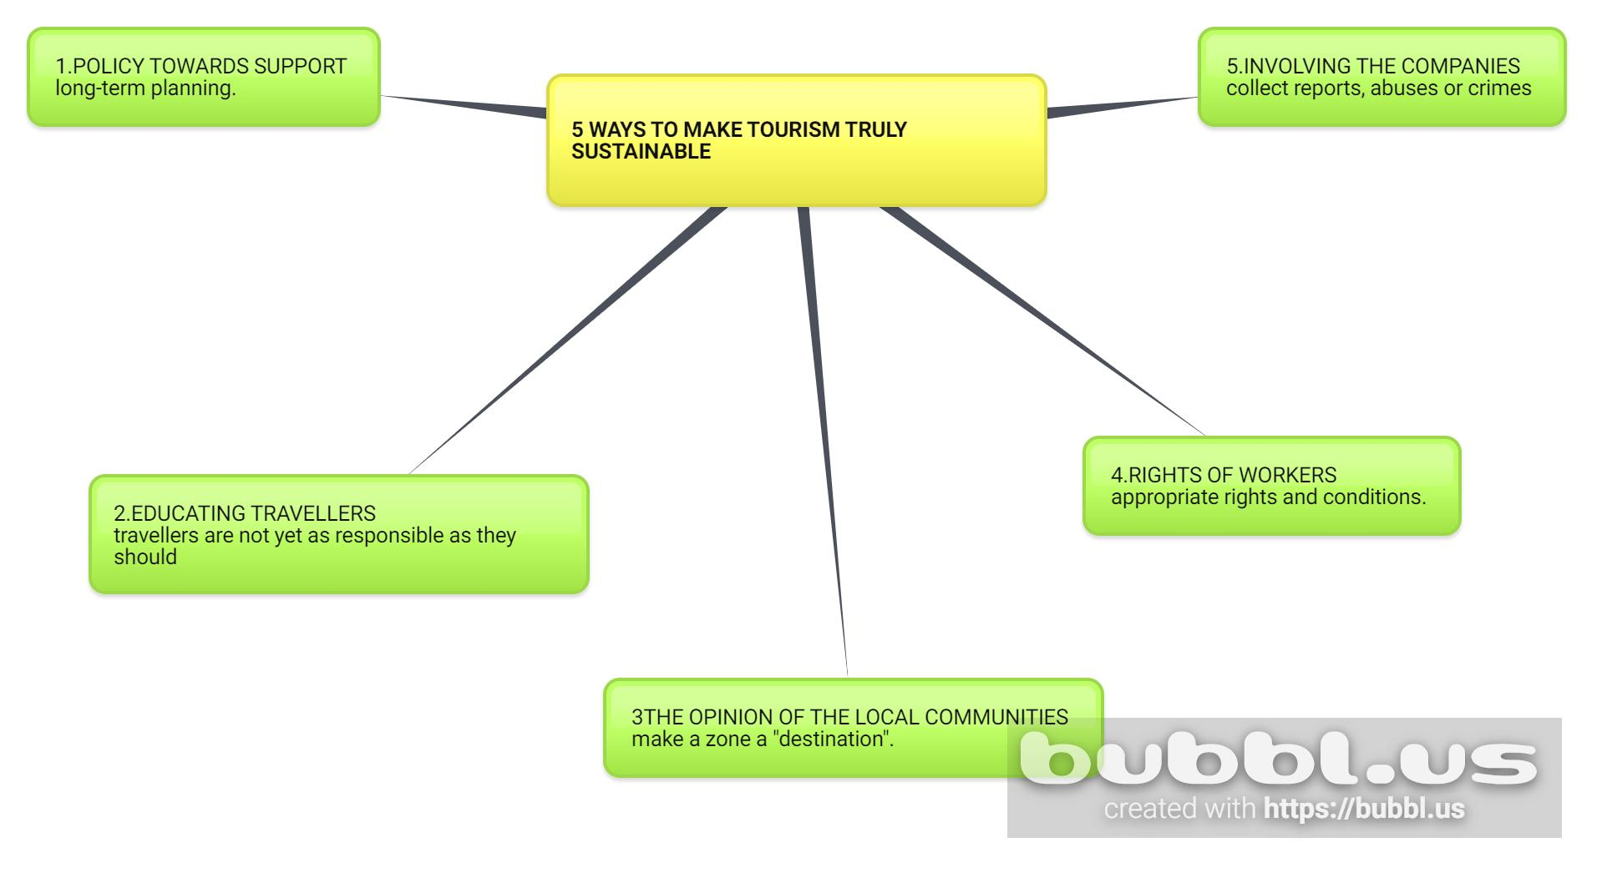

Slide 12
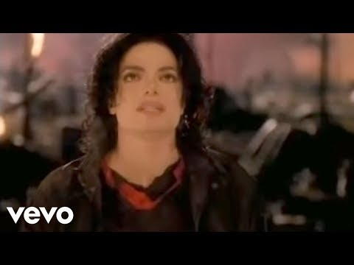
EARTH DOES’NT BELONG TO MAN
MAN BELONGS TO EARTH
LET’S FIX THE PLANET
THERE IS NO ANOTHER ONE
CONTRIBUTE TOO
https://youtu.be/SRjyDviJhAs
Earth Song – MichaeJackson l – video +text
https://youtu.be/XAi3VTSdTxU
Earth Song – Michael Jackson official video

Slide 13
EARTH HAS ENOUGH FOR EVERYONE'S NEEDS
BUT NOT FOR THE GREED OF A FEW PEOPLE
https://youtu.be/Xv1v8Addsgs
https://youtu.be/euYGSkCdBVU
THANK YOU SO MUCH FOR ATTENTION

